Slide 1
House Price Prediction: Survey of Data Mining Methods and Regression Techniques
Radhika Reddy
Kusala Nagamani Reddy
Date : 04/15/2024

Slide 2
Objective:
This dataset contains house sale prices for King County, which includes Seattle.
To conduct a comprehensive analysis of various factors influencing house prices.
Provide stakeholders with accurate price predictions through data-driven insights for informed decision-making in real estate transactions.
Dataset contains more than 21k records and 23 columns.
Combination of numerical and categorical.
Sourced from Kaggle.
Kaggle link: House Sales in King County, USA (kaggle.com)

Slide 3
Variables to analyze and predict the house prices:
price | 600000 | 190000 | 735000 | 257000 | 450000
room_bed | 4 | 2 | 4 | 3 | 2
room_bath | 1.75 | 1 | 2.75 | 2.5 | 1
living_measure | 3050 | 670 | 3040 | 1740 | 1120
lot_measure | 9440 | 3101 | 2415 | 3721 | 4590
ceil | 1 | 1 | 2 | 2 | 1
coast | 0 | 0 | 1 | 0 | 0
sight | 0 | 0 | 4 | 0 | 0
condition | 3 | 4 | 3 | 3 | 3
quality | 8 | 6 | 8 | 8 | 7
ceil_measure | 1800 | 670 | 3040 | 1740 | 1120
basement | 1250 | 0 | 0 | 0 | 0
yr_built | 1966 | 1948 | 1966 | 2009 | 1924
yr_renovated | 0 | 0 | 0 | 0 | 0
zipcode | 98034 | 98118 | 98118 | 98002 | 98118
lat | 47.7228 | 47.5546 | 47.5188 | 47.3363 | 47.5663
long | -122.18 | -122.27 | -122.26 | -122.21 | -122.29
living_measure15 | 2020 | 1660 | 2620 | 2030 | 1120
lot_measure15 | 8660 | 4100 | 2433 | 3794 | 5100
furnished | 0 | 0 | 0 | 0 | 0
total_area | 12490 | 3771 | 5455 | 5461 | 5710

Slide 4
Data Pre-processing:
Identifying numerical and categorical variables.
Identifying and addressing issues with the data.
Plotting the date and zip code plots.
Missing value treatment.
Identifying if there are outliers in data.
Data Visualization.

Slide 5
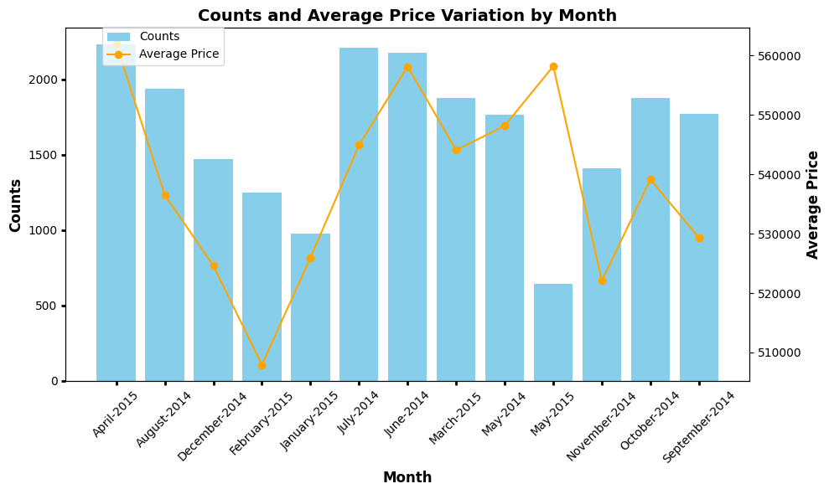

Slide 6
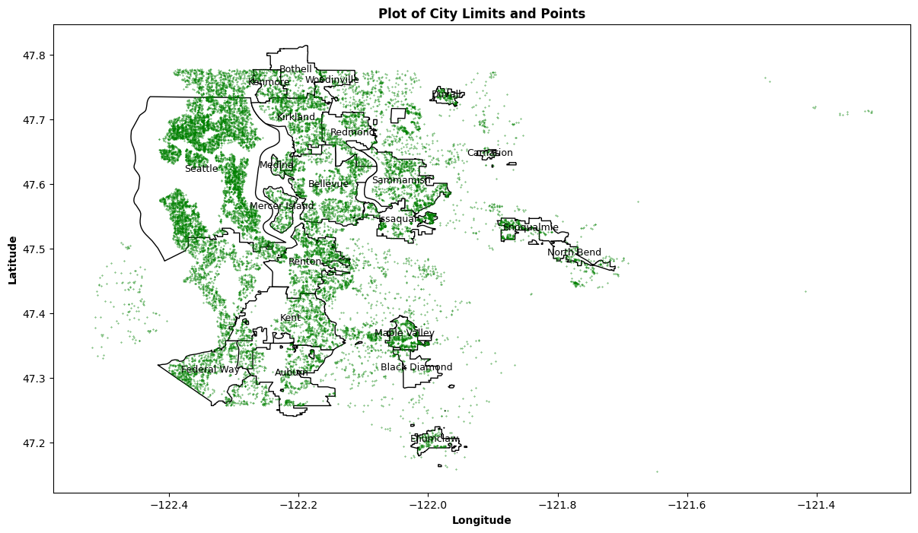

Slide 7
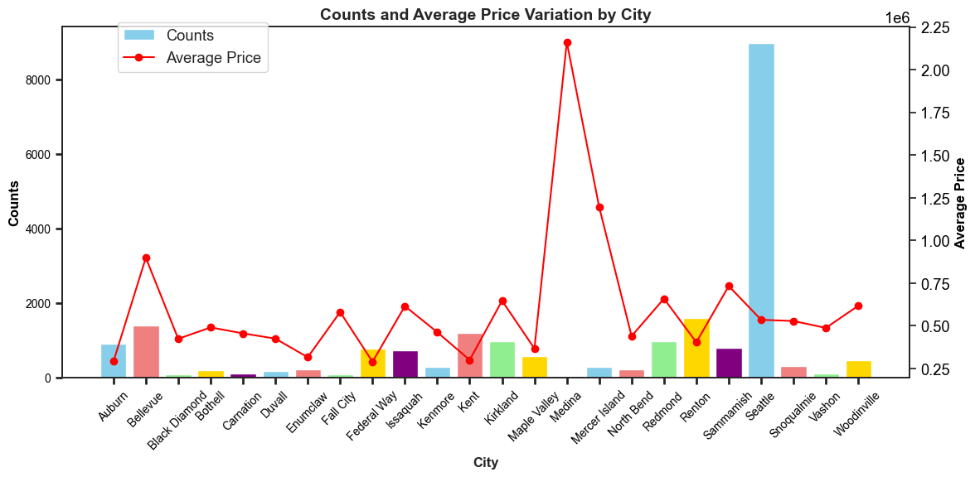

Slide 8
Statistical summary:
Variable | Mean | Std | Min | 25% | 50% | 75% | Max
Price $ | 540182 | 367362 | 75000 | 321950 | 450000 | 645000 | 7700000
Living Measure (sq. foot) | 2079.86 | 918.496 | 290 | 1429.3 | 1910 | 2550 | 13540
Lot Measure (sq. foot) | 15104.6 | 41423.6 | 520 | 5040 | 7618 | 10684.5 | 1651359
Ceil Measure (sq. foot) | 1788.37 | 828.103 | 290 | 1190 | 1560 | 2210 | 9410
Basement (sq. foot) | 291.523 | 442.581 | 0 | 0 | 0 | 560 | 4820
Living Measure15 (sq. foot) | 1987.07 | 685.52 | 399 | 1490 | 1840 | 2360 | 6210
Lot Measure15 (sq. foot) | 12766.5 | 27287 | 651 | 5100 | 7620 | 10087 | 871200
Total Area (sq. foot) | 17192 | 41628.7 | 1423 | 7032 | 9575 | 13000 | 1652659

Slide 9
Interpretation of statistical summary of the data:
Price varies from $ 75,000 to $7,700,000, The median (50th percentile) price is $450,000, which indicates that half of the houses have prices below this value.
The lot measure ranges from 520 square feet to 1,651,359 square feet, showing significant variability in the sizes of lots. living measurement, ceil measurement, basement measurement, and total area.
This might mean there are outliers in the data.
The values show lot of variability in the given data.

Slide 10
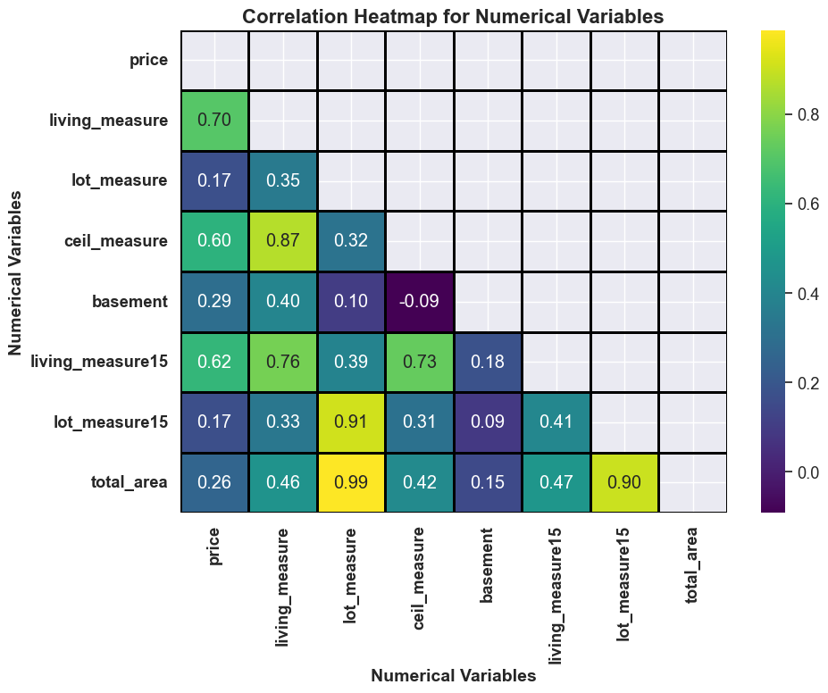
Correlation Heatmap

Slide 11
Missing values
room_bed | 108
room_bath | 108
living_measure | 17
lot_measure | 42
cei | 72
coas | 31
sight | 57
condition | 85
quality | 1
ceil_measure | 1
basement | 15
living_measure15 | 166
lot_measure15 | 29
furnished | 29
total_area | 68
Detected missing values across various features in the dataset.
Imputed missing values using appropriate strategies such as median or mean imputation.
For instance, in the 'living_measure15' variable, 166 missing values were imputed using the median.
Overall Treating missing values to ensure data integrity, prevent bias, and improve the performance and interpretability of statistical analyses and predictive models.

Slide 12
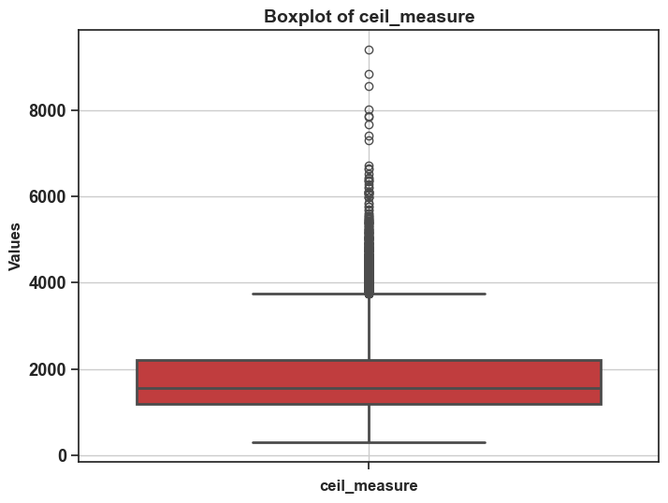
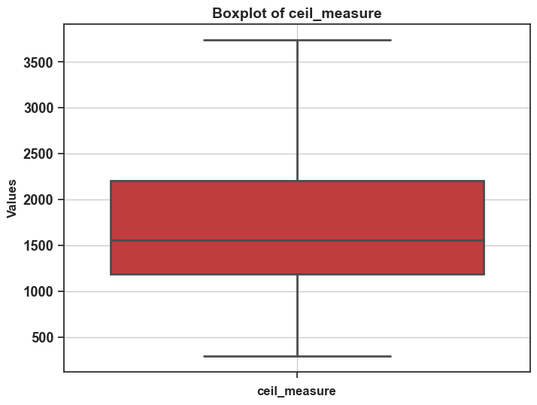
Outlier treatment:
Identified outliers using the Interquartile Range (IQR) method.
Treated outliers by capping them at a certain threshold based on the IQR as shown below for the ceil Measure feature.
For example, in the 'lot_measure' variable, 42 outliers were identified and treated using the IQR method.
Variable | Number of Outliers
price | 1159
living_measure | 572
lot_measure | 2426
ceil_measure | 611
basement | 496
living_measure15 | 540
lot_measure15 | 2192
total_area | 2418

Slide 13
Inference from visualization:
The built year of the properties range from 1900 to 2014.
Majority of the properties have bathrooms in the range of 1.0 to 2.5.
Most of the houses/properties have 3 or 4 bedrooms.
60% of the properties without basement.
Only 914 houses were renovated out of 21613 houses.
Total area, lot measure, and lot_measure15 give giving same info.
Consider dropping living_measure15 as it's giving the same info as the living measure.
Renovated properties have a higher price than others with the same living measure space.
Furnished houses have a higher price than that of the Non-furnished houses.

Slide 14
Feature engineering & clustering
Derived from the construction year to capture the age of the house.
Removed redundant features like Living Measure and Lot Measure to improve model efficiency.
Scaled the remaining features to ensure uniformity and improve model performance.
Utilized clustering to segment the data into two distinct groups.
Conducted regression separately on each cluster to better capture underlying patterns and relationships.

Slide 15
Cluster profiles
Clus_kmeans | 0 | 1
price | 795,302.170134 | 417,491.375870
room_bed | 3.950223 | 3.176844
room_bath | 2.852990 | 1.872959
ceil | 1.852062 | 1.373190
coast | 0.025260 | 0.001540
sight | 0.594168 | 0.114178
condition | 3.264302 | 3.455296
quality | 9.164933 | 7.156510
ceil_measure | 2,754.259844 | 1,442.841888
basement | 346.415862 | 263.360219
living_measure15 | 2,746.030646 | 1,718.633680
lot_measure15 | 10,805.918462 | 7,465.668864
furnished | 0.770245 | 0.006100
total_area | 14,554.404718 | 9,512.581552
house_age | 33.257801 | 56.367614
freq | 5,384.000000 | 16,229.000000

Slide 16
Model training and evaluation
Linear Regression Model
Utilized to predict housing prices based on various features.
Data split
The dataset was divided into training and test sets using a 70:30 ratio.
Performance metrics
R-squared (R²) Score:
Train Set: 0.659
Test Set: 0.651
Root Mean Squared Error (RMSE):
Train Set: $146,602
Test Set: $146,174
Feature Importance
Examined the importance of features in predicting housing prices.

Slide 17
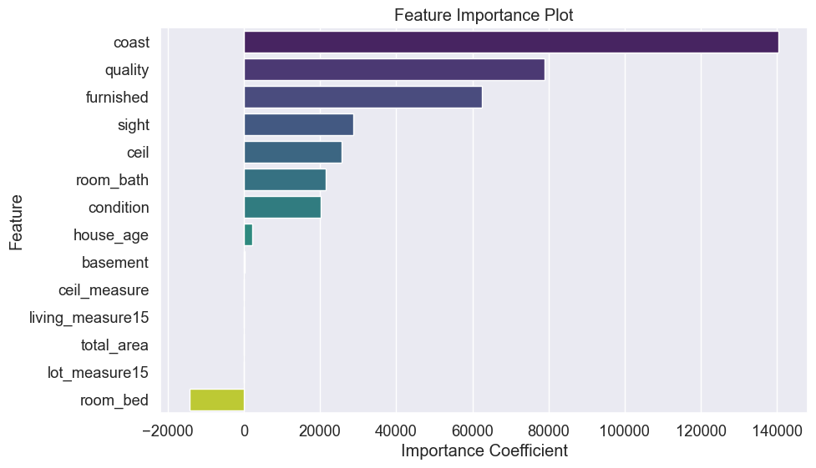
Feature importance

Slide 18
Regression results taking all features and without hyperparameter tuning.
 | Train RMSE | Test RMSE | Training Score | Test Score
Linear Regression | 146602.060 | 146173.568 | 0.659 | 0.651
Decision Tree Regressor | 8286.192 | 181869.337 | 0.999 | 0.460
Random Forest Regressor | 49285.739 | 129987.627 | 0.961 | 0.724

Slide 19
Optimizing model performance
Grid search hyperparameter tuning:
Utilized grid search to fine-tune hyperparameters.
Achieved optimal settings:
Max Depth: 20
Min Samples Leaf: 30
Min Samples Split: 15
Cross-Validation:
Employed cross-validation to ensure robustness.
Assessing overfitting:
Evaluated if the model still exhibits overfitting.

Slide 20
Regression results after hyperparameter tuning
 | Train RMSE | Test RMSE | Training Score | Test Score
Linear Regression | 146602.06 | 146173.57 | 0.659 | 0.651
Decision Tree Regressor | 127342.60 | 142514.23 | 0.743 | 0.668
Random Forest Regressor | 120945.44 | 133225.85 | 0.768 | 0.710

Slide 21
Summary
Explored the dataset, and prepared the data by handling missing values and encoding categorical variables.
Explored the relationships between different features.
Conducted clustering analysis.
Utilized Linear Regression, Decision Tree Regression, and Random Forest Regression.
Split the data into training and testing sets.
Trained the models on the training data and evaluated their performance on the testing data.
Calculated performance metrics such as RMSE and R-squared for each model.
Examined the importance of features in the Linear Regression model.
Used Grid Search to find the best hyperparameters.
Evaluated the performance cross-validation and checked for overfitting.

Slide 22
Conclusions:
Achieved a variance of 70% in the data, indicating good model performance.
Identified key features influencing property pricing: furnished, house age, lot measure, quality, sight, and condition.
Further improvement includes handling outliers differently and hyper-tuning ensemble models.
Additional data would provide insights and improve our model's performance.
Commuting time: The time it takes from the house location to downtown Seattle could be a good indicator, with better-connected properties potentially being valued higher.
Median Income per zipcode Understanding income distribution amongst zipcodes would also be an indicator of which neighborhoods are more affluent and should be the focus of the campaign.
Potential for enhancing model performance with additional techniques such as Artificial Neural Networks, Ridge and Lasso Regression, and Boosting techniques.

Slide 23
References
Frontiers | Differential Impact of COVID-19 Risk Factors on Ethnicities in the United States (frontiersin.org)
A Comprehensive Guide on Hyperparameter Tuning and its Techniques (analyticsvidhya.com)
Regression Analysis: Step by Step Articles, Videos, Simple Definitions (statisticshowto.com)
Regression analysis—ArcGIS Insights | Documentation
Subhani Shaik, Uppu Ravibabu. Classification of EMG Signal Analysis based on Curvelet Transform and Random Forest tree Method. Paper selected for Journal of Theoretical and Applied Information Technology (JATIT). 95. 15.
Shiva Keertan J, Subhani Shaik. Machine Learning Algorithms Prediction, for International Oil Journal Price of Innovative Technology and Exploring Engineering. 8(8). 16.
KP Surya Teja, Vigneswar Reddy and Subhani Shaik, Flight Delay Prediction Using Machine Learning Algorithm XGBoost, Jour of Adv Research in Dynamical & Control Systems. 11(5).

Slide 24
Acknowledgements
Prof. Sumona Mondal
Thevasha Sathiyakumar
Prof. Tyler Conlon

Slide 25
THANK YOU

